Slide 1

Customer Shopping Behavior Analysis
This project delves into customer shopping behavior using transactional data from 3,900 purchases. Our primary objective is to unearth actionable insights into spending patterns, customer segmentation, product preferences, and subscription behaviors. These insights will serve as a foundation for guiding strategic business decisions, optimizing marketing efforts, and enhancing overall customer experience.
By analyzing a comprehensive dataset, we aim to provide a holistic view of our customer base, enabling more targeted and effective strategies across various business functions.

Slide 2

Project Overview & Dataset Summary
Project Goal
Dataset Scope
Uncover insights into spending patterns, customer segments, product preferences, and subscription behavior to guide strategic business decisions.
Analyzed 3,900 purchases across various product categories, providing a rich source of transactional data.
Key Features
Data Snapshot
Customer demographics (Age, Gender, Location, Subscription Status)
Rows: 3,900
Purchase details (Item Purchased, Category, Purchase Amount, Season, Size, Color)
Columns: 18
Shopping behavior (Discount Applied, Promo Code Used, Previous Purchases, Frequency of Purchases, Review Rating, Shipping Type)
Missing Data: 37 values in Review Rating column

Slide 3
Exploratory Data Analysis with Python
Our initial phase involved robust data preparation and cleaning using Python, ensuring the integrity and usability of our dataset for subsequent analysis.
01
02
03
Data Loading
Initial Exploration
Missing Data Handling
Imported the dataset efficiently using the pandas library, setting the foundation for analysis.
Utilized df.info() for structural overview and .describe() for comprehensive summary statistics, identifying key characteristics.
Identified and imputed 37 missing values in the Review Rating column using the median rating specific to each product category.
04
05
06
Column Standardization
Feature Engineering
Data Consistency Check
Renamed all columns to snake_case for improved readability, consistency, and better documentation practices.
Created new features: age_group by binning customer ages and purchase_frequency_days derived from purchase data.
Verified redundancy between discount_applied and promo_code_used, leading to the removal of promo_code_used.
07
Database Integration
Connected the cleaned DataFrame to PostgreSQL, preparing it for advanced SQL-based analytical queries.

Slide 4
SQL Analysis: Revenue & Discounts
Leveraging PostgreSQL, we conducted a structured analysis to address critical business questions regarding revenue generation and discount utilization.
Revenue by Gender
High-Spending Discount Users
Comparing total revenue generated by male versus female customers reveals distinct spending patterns.
Identified 839 customers who utilized discounts yet maintained an above-average purchase amount, highlighting effective discount strategies.
Female
75191
2
64
Male
157890
3
73
Male customers contribute significantly more to total revenue, indicating potential for targeted marketing towards female segments.
4
90
7
85
9
97
These customers represent a valuable segment that responds well to promotions without compromising overall spend.

Slide 5
SQL Analysis: Product & Shipping Insights
Further SQL analysis provided insights into product performance and the impact of different shipping types on purchase behavior.
Top 5 Products by Rating
Shipping Type Comparison
Identifying products with the highest average review ratings helps in prioritizing inventory and marketing efforts.
Comparing average purchase amounts between Standard and Express shipping reveals customer willingness to pay for speed.
Gloves
3.86
Standard
58.46
Sandals
3.84
Express
60.48
Boots
3.82
Customers using Express shipping tend to have slightly higher average purchase amounts, suggesting a premium service attracts higher-value transactions.
Hat
3.80
Skirt
3.78
These top-rated items can be leveraged in promotional campaigns to attract new customers and build brand trust.

Slide 6
SQL Analysis: Subscription & Discount Dependency
Understanding the dynamics of subscription status and discount dependency is crucial for optimizing pricing and loyalty programs.
Subscribers vs. Non-Subscribers
Discount-Dependent Products
Analysis of average spend and total revenue across subscription statuses provides insights into subscriber value.
Identifying products with the highest percentage of discounted purchases helps in understanding price elasticity and promotional effectiveness.
Yes
1053
59.49
Hat
50.00
No
2847
59.87
Sneakers
49.66
While non-subscribers contribute more to total revenue due to their larger numbers, average spend per customer is comparable, indicating potential to convert non-subscribers.
Coat
49.07
Sweater
48.17
Pants
47.37
These products are highly sensitive to discounts, suggesting that promotions are a key driver for their sales.

Slide 7




SQL Analysis: Customer Segmentation
Segmenting customers based on their purchase history allows for tailored marketing strategies and improved customer relationship management.
New Customers
Returning Customers
Loyal Customers
83 customers, representing recent acquisitions with limited purchase history.
701 customers, indicating repeat engagement but not yet consistent loyalty.
3116 customers, forming the core of our customer base with frequent and consistent purchases.
This segmentation provides a clear picture of our customer base, enabling targeted strategies to convert new customers, retain returning ones, and reward loyal patrons.

Slide 8
SQL Analysis: Product Hierarchy & Repeat Buyers
Understanding product popularity within categories and the subscription likelihood of repeat buyers offers valuable insights for merchandising and loyalty programs.
Top 3 Products per Category
Repeat Buyers & Subscriptions
Identifying the most purchased items within each category helps optimize inventory and promotional focus.
Investigating whether customers with more than 5 purchases are more inclined to subscribe.
1
Accessories
Jewelry
171
No
2518
1
Clothing
Blouse
171
Yes
958
1
Footwear
Sandals
160
A significant portion of repeat buyers are not subscribed, indicating a strong opportunity to convert them into subscribers.
1
Outerwear
Jacket
163
These top-performing products within each category should be highlighted in marketing and inventory management.

Slide 9
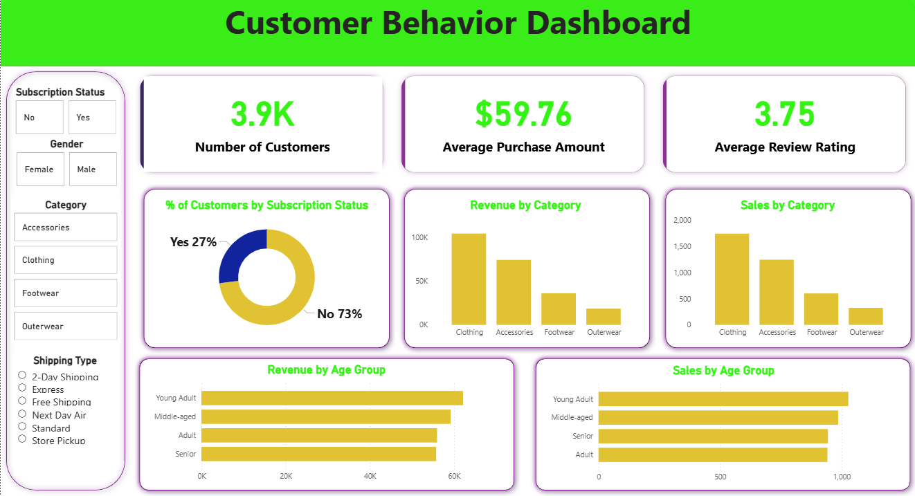
Power BI Dashboard: Visualizing Customer Behavior
An interactive Power BI dashboard was developed to visually present key insights, making complex data accessible and actionable.
Key Metrics
3.9K Number of Customers
$59.76 Average Purchase Amount
3.75 Average Review Rating
Filters
Subscription Status (No, Yes)
Gender (Female, Male)
Category (Accessories, Clothing, Footwear, Outerwear)
Shipping Type (2-Day Shipping, Express, Free Shipping, Next Day Air, Standard, Store Pickup)
The dashboard provides a dynamic interface for exploring customer data, allowing for granular analysis and quick identification of trends.

Slide 10




Business Recommendations
Based on our comprehensive analysis, we propose the following strategic recommendations to optimize business performance and enhance customer engagement.
Boost Subscriptions
Implement targeted campaigns promoting exclusive benefits for subscribers to increase conversion rates and recurring revenue.
Customer Loyalty Programs
Develop and launch robust loyalty programs to reward repeat buyers, encouraging them to transition into the "Loyal" customer segment.
Review Discount Policy
Strategically re-evaluate discount policies to balance sales boosts with margin control, ensuring profitability while attracting customers.
Product Positioning
Highlight top-rated and best-selling products in marketing campaigns and store layouts to capitalize on their proven appeal.
Targeted Marketing
Focus marketing efforts on high-revenue age groups and customers who prefer express shipping, leveraging their demonstrated spending power.

